Slide 1

How to use Text to Speech
Notes:
Welcome to, how to use text to speech in powerpoint.

Slide 2
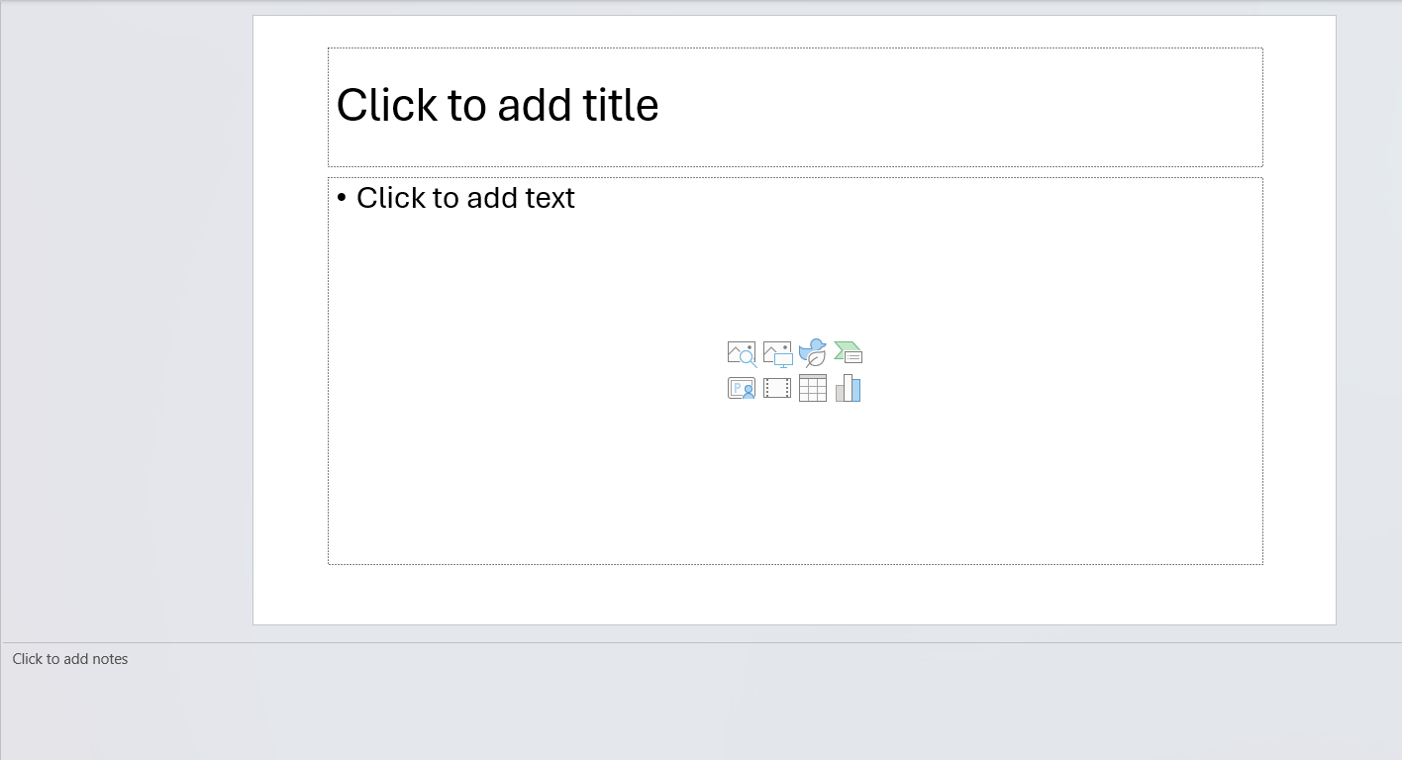
Notes:
To utilize the Text To Speech, first, add notes the bottom box. These notes are what will be read by the AI.

Slide 3
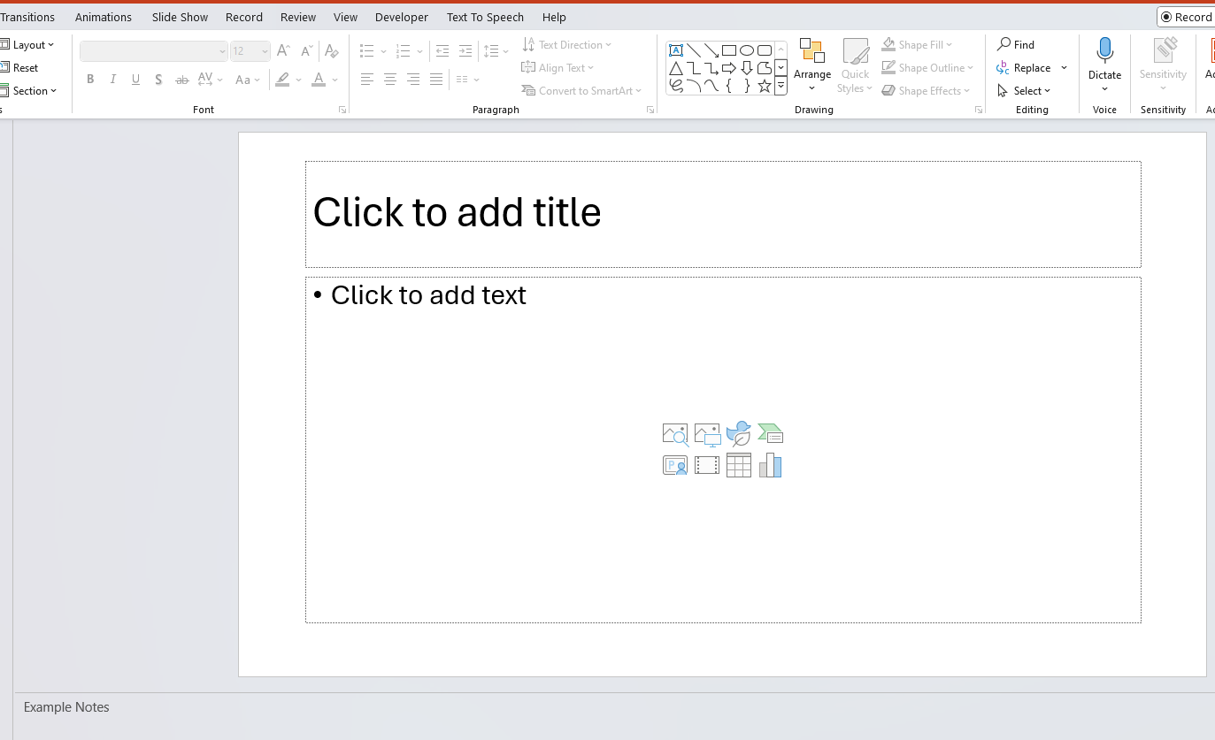
Notes:
At the top of the Tool Bar should be a Text To Speech tab. Click on this.

Slide 4
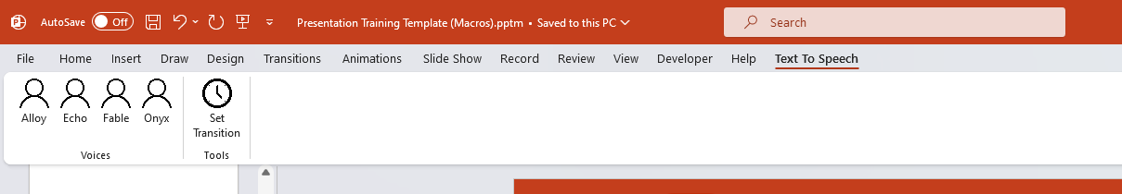
Notes:
Now you can Select the voice that you would like to read the text.

Slide 5
Notes:
After you have created all your slides and added sound files. Click the Set Transition button. This will add transitions and timings to line up with the presentation.

Slide 6
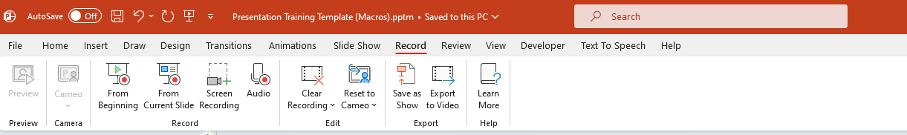
Notes:
When done, To Record, click on the Record tab and then select the Export to Video.

Slide 7
END
Notes:
Example End Slide

